Slide 1
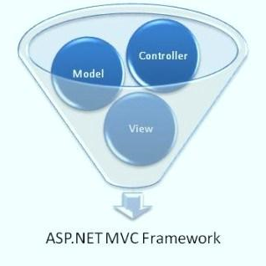



ASP.NET MVC Essentials
ASP.NET MVC
Telerik Software Academy
http://academy.telerik.com

Slide 2


Table of Contents
ASP.NET MVC Routing
Route constraints
Controllers and Actions
Action results and filters
Razor Views
Layout and sections
Helpers
Partial views
Bundling and Minification
Areas

Slide 3

ASP.NET MVC Routing

Slide 4
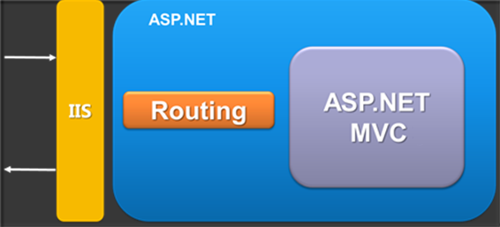
ASP.NET MVC Routing
Mapping between patterns and a combination of controller + action + parameters
Routes are defined as a global list of routes
System.Web.Routing.RouteTable.Routes
Something similar to Apache mod_rewrite
Greedy algorithm
the first match wins

Slide 5
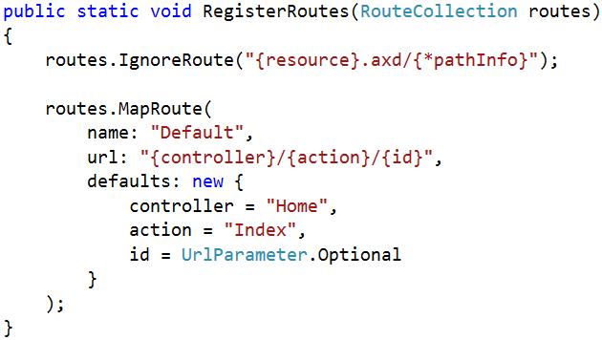
Register routes
In Global.asax in the Application_Start() there is RouteConfig.RegisterRoutes(RouteTable.Routes);
RoutesConfig class is located in /App_Start/ in internet applications template by default
Routes to ignore
The [*] means all left
Route name
Route pattern
Default parameters

Slide 6
Routing Examples
http://localhost/Products/ById/3
Controller: Products
Action: ById
Id: 3

Slide 7
Routing Examples (2)
http://localhost/Products/ById
Controller: Products
Action: ById
Id: 0 (optional parameter)

Slide 8
Routing Examples (3)
http://localhost/Products
Controller: Products
Action: Index
Id: 0 (optional parameter)

Slide 9
Routing Examples (4)
http://localhost/
Controller: Home
Action: Index
Id: 0 (optional parameter)

Slide 10
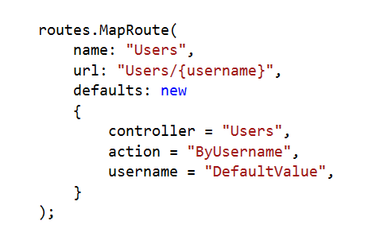
Custom Route
http://localhost/Users/NikolayIT
Controller: Users
Action: ByUsername
Username: NikolayIT

Slide 11
Custom Route (2)
http://localhost/Users
Controller: Users
Action: ByUsername
Username: DefaultValue

Slide 12
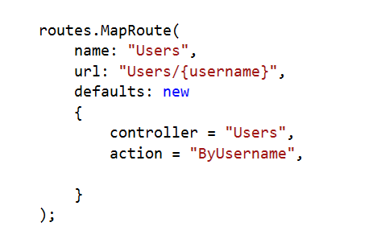
Custom Route (3)
?
http://localhost/Users
Result: 404 Not Found

Slide 13
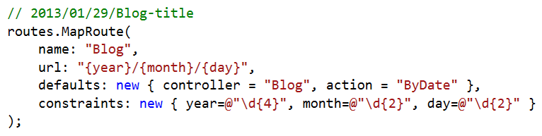
Route Constraints
Constraints are rules on the URL segments
All the constraints are regular expression compatible with the Regex class
Defined as one of the routes.MapRoute(…) parameters

Slide 14
Custom Route Constraint
public class LocalhostConstraint : IRouteConstraint
{
public bool Match(HttpContextBase httpContext,
Route route,
string parameterName,
RouteValueDictionary values,
RouteDirection routeDirection)
{
return httpContext.Request.IsLocal;
}
}
routes.MapRoute("Admin",
"Admin/{action}",
new { controller="Admin" },
new {isLocal = new LocalhostConstraint()}
);

Slide 15
Debugging Routes
In actions we have access to a data structure called RouteData
RouteData.Values["controller"]
RouteData.Values["action"]
RouteData.Values["id"]
We can use NuGet package RouteDebugger
Install-Package RouteDebugger
Web.config: <add key="RouteDebugger:Enabled" value="true" />
We can also use Glimpse for debugging routes

Slide 16
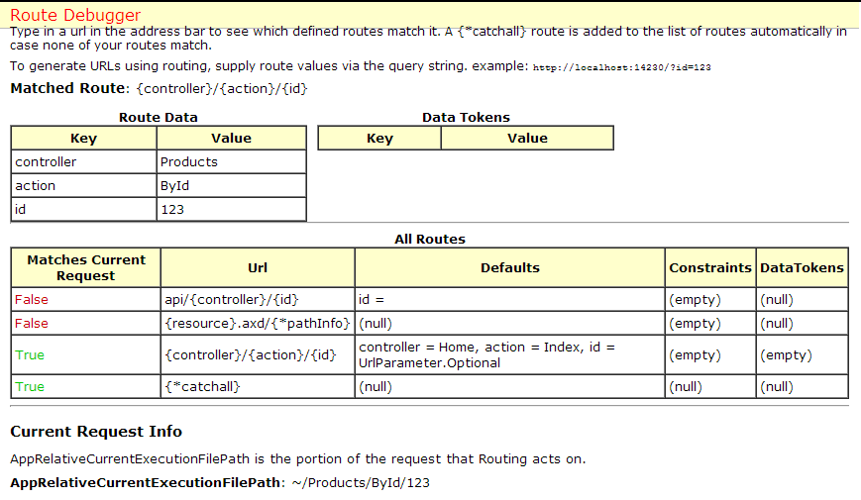
Live Demo: Routes
ASP.NET MVC Routing

Slide 17

Controllers and Actions
The brain of the application

Slide 18
Controllers
The core component of the MVC pattern
All the controllers should be available in a folder by name Controllers
Controller naming standard should be "nameController" (convention)
Routes select controllers in every request
All requests are mapped to a specific action
Every controller should inherit Controller class
Access to Request (context) and HttpContext

Slide 19
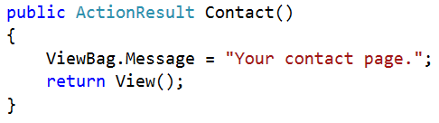
Actions
Actions are the ultimate request destination
Public controller methods
Non-static
No return value restrictions
Actions typically return an ActionResult

Slide 20
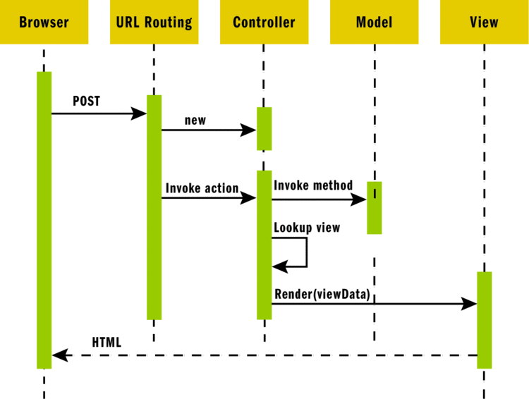
ASP.NET MVC Request

Slide 21
Action Results
Controller action response to a browser request
Inherits from the base ActionResult class
Different results types:
Name | Framework Behavior | Producing Method
ContentResult | Returns a string literal | Content
EmptyResult | No response
FileContentResult FilePathResult FileStreamResult | Return the contents of a file | File

Slide 22
Action Results (2)
Name | Framework Behavior | Producing Method
HttpUnauthorizedResult | Returns an HTTP 403 status
JavaScriptResult | Returns a script to execute | JavaScript
JsonResult | Returns data in JSON format | Json
RedirectResult | Redirects the client to a new URL | Redirect / RedirectPermanent
RedirectToRouteResult | Redirect to another action, or another controller’s action | RedirectToRoute / RedirectToAction
ViewResult PartialViewResult | Response is the responsibility of a view engine | View / PartialView

Slide 23
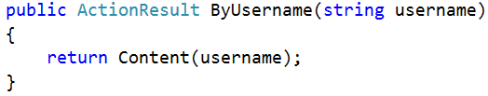
Action Parameters
ASP.NET MVC maps the data from the HTTP request to action parameters in few ways:
Routing engine can pass parameters to actions
http://localhost/Users/NikolayIT
Routing pattern: Users/{username}
URL query string can contains parameters
/Users/ByUsername?username=NikolayIT
HTTP post data can also contain parameters

Slide 24
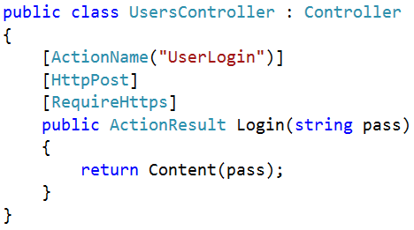
Action Selectors
ActionName(string name)
AcceptVerbs
HttpPost
HttpGet
HttpDelete
HttpOptions
…
NonAction
RequireHttps
ChildActionOnly – Only for Html.Action()

Slide 25
Action Filters
Apply pre- and post-processing logic
Similar to HTTP Modules
Can be applied to actions and to controllers
Global filters can be registered in GlobalFilters. Filters (or in /App_Start/FilterConfig.cs)
Name | Description
OutputCache | Cache the output of a controller (action)
ValidateInput(false) | Turn off request validation and allow dangerous input (html tags)
Authorize | Restrict an action to authorized users or roles
ValidateAntiForgeryToken | Helps prevent cross site request forgeries (CSRF)
HandleError | Can specify a view to render in the event of an unhandled exception

Slide 26

Custom Action Filter
Create C# class file in /Filters/
Inherit ActionFilterAttribute
We can override:
OnActionExecuting(ActionExecutingContext)
OnActionExecuted(ActionExecutedContext)
OnResultExecuting(ResultExecutingContext)
OnResultExecuted(ResultExecutedContext)
We can apply our new attribute to a controller, method or globally in GlobalFilters.Filters

Slide 27
Custom Action Filter (2)
public class LogAttribute : ActionFilterAttribute
{
public override void OnActionExecuting (ActionExecutingContext filterContext) { /* */ }
public override void OnActionExecuted (ActionExecutedContext filterContext) { /* */ }
public override void OnResultExecuting (ResultExecutingContext filterContext) { /* */ }
public override void OnResultExecuted (ResultExecutedContext filterContext) { /* */ }
}
[Log]
public class DepartmentController : Controller { // ... }

Slide 28
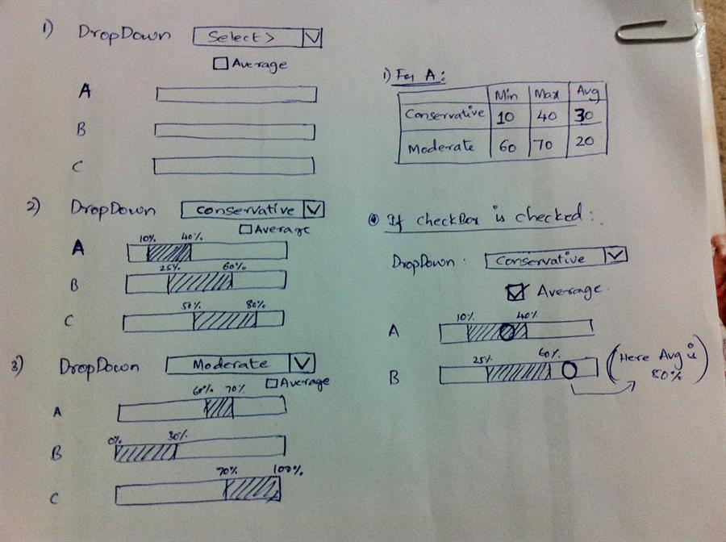
Razor Views

Slide 29
Views
HTML templates of the application
A lot of view engines available
View engines execute code and provide HTML
Provide a lot of helpers to easily generate HTML
The most popular is Razor and WebForms
We can pass data to views through ViewBag, ViewData and Model (strongly-typed views)
Views support master pages (layout views)
Other views can be rendered (partial views)

Slide 30
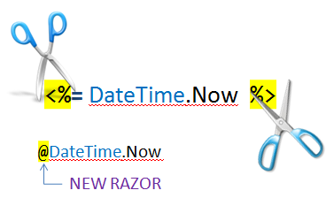
Razor
Template markup syntax
Simple-syntax view engine
Based on the C# programming language
Enables the programmer to use an HTML construction workflow
Code-focused templating approach, with minimal transition between HTML and code
Razor syntax starts code blocks with a @ character and does not require explicit closing of the code-block

Slide 31
Design Goals
Compact, Expressive, and Fluid
Smart enough to differ HTML from code
Easy to Learn
Is not a new language
Works with any Text Editor
Has great Intellisense
Built in Visual Studio
Unit Testable
Without requiring a controller or web-server
Template
+
Data
=
Generated Output

Slide 32
Pass Data to a View
With ViewBag (dynamic type):
Action: ViewBag.Message = "Hello World!";
View: @ViewBag.Message
Strongly-typed views:
Action: return View(model);
View: @model ModelDataType;
With ViewData (dictionary)
Action: ViewData["Message"] = "Hello World!";
View: @ViewData["Message"]

Slide 33
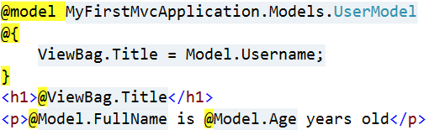

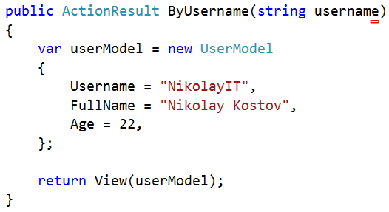
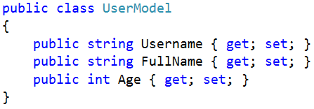
How it works?
ByUsername.cshtml
HTML Output
Template
+
Data
=
Generated Output
UsersController.cs
UserModel.cs

Slide 34
Razor Syntax
@ – For values (HTML encoded)
@{ … } – For code blocks (keep the view simple!)
<p>
Current time is: @DateTime.Now!!!
Not HTML encoded value: @Html.Raw(someVar)
</p>
@{
var productName = "Energy drink";
if (Model != null)
{
productName = Model.ProductName;
}
else if (ViewBag.ProductName != null)
{
productName = ViewBag.ProductName;
}
}
<p>Product "@productName" has been added in your shopping cart</p>

Slide 35
Razor Syntax (2)
If, else, for, foreach, etc. C# statements
HTML markup lines can be included at any part
@: – For plain text line to be rendered
<div class="products-list">
@if (Model.Products.Count() == 0)
{
<p>Sorry, no products found!</p>
}
else
{
@:List of the products found:
foreach(var product in Model.Products)
{
<b>@product.Name, </b>
}
}
</div>

Slide 36
Razor Syntax (3)
Comments
What about "@" and emails?
@*
A Razor Comment
*@
@{
//A C# comment
/* A Multi
line C# comment
*/
}
<p>
This is the sign that separates email names from domains: @@<br />
And this is how smart Razor is: spam_me@gmail.com
</p>

Slide 37
Razor Syntax (4)
@(…) – Explicit code expression
@using – for including namespace into view
@model – for defining the model for the view
<p>
Current rating(0-10): @Model.Rating / 10.0 @* 6 / 10.0 *@
Current rating(0-1): @(Model.Rating / 10.0) @* 0.6 *@
spam_me@Model.Rating @* spam_me@Model.Rating *@
spam_me@(Model.Rating) @* spam_me6 *@
</p>
@using MyFirstMvcApplication.Models;
@model UserModel
<p>@Model.Username</p>

Slide 38
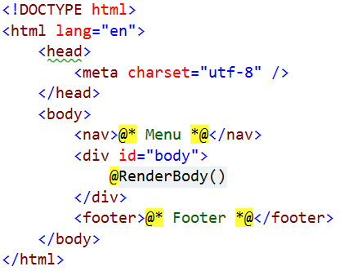
Layout
Define a common site template
Similar to ASP.NET master pages (but better!)
Razor view engine renders content inside-out
First view is redered, then layout
@RenderBody() – indicate where we want the views based on this layout to “fill in” their core content at that location in the HTML

Slide 39
Views and Layouts
Views don't need to specify layout since their default layout is set in their _ViewStart file:
~/Views/_ViewStart.cshtml (code for all views)
Each view can specify custom layout pages
Views without layout:
@{
Layout = "~/Views/Shared/_UncommonLayout.cshtml";
}
@{
Layout = null;
}

Slide 40
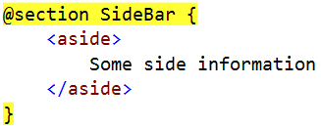
Sections
You can have one or more "sections" (optional)
They are defined in the views:
And may be rendered anywhere in the layout page using the method RenderSection()
@RenderSection(string name, bool required)
If the section is required and not defined, an exception will be thrown (IsSectionDefined())

Slide 41
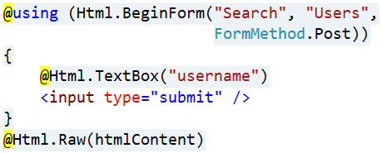
View Helpers
Each view inherits WebViewPage
ViewPage has a property named Html
Html property has methods that return string and can be used to generate HTML
Create inputs
Create links
Create forms
Other helper properties are also available
Ajax, Url, custom helpers

Slide 42
HTML Helpers
Method | Type | Description
BeginForm, BeginRouteForm | Form | Returns an internal object that represents an HTML form that the system uses to render the <form> tag
EndForm | Form | A void method, closes the pending </form> tag
CheckBox, CheckBoxFor | Input | Returns the HTML string for a check box input element
Hidden, HiddenFor | Input | Returns the HTML string for a hidden input element
Password, PasswordFor | Input | Returns the HTML string for a password input element
RadioButton, RadioButtonFor | Input | Returns the HTML string for a radio button input element
TextBox, TextBoxFor | Input | Returns the HTML string for a text input element
Label, LabelFor | Label | Returns the HTML string for an HTML label element

Slide 43
HTML Helpers (2)
Method | Type | Description
ActionLink, RouteLink | Link | Returns the HTML string for an HTML link
DropDownList, DropDownListFor | List | Returns the HTML string for a drop-down list
ListBox, ListBoxFor | List | Returns the HTML string for a list box
TextArea, TextAreaFor | TextArea | Returns the HTML string for a text area
Partial | Partial | Returns the HTML string incorporated in the specified user control
RenderPartial | Partial | Writes the HTML string incorporated in the specified user control to the output stream
ValidationMessage, ValidationMessageFor | Validation | Returns the HTML string for a validation message
ValidationSummary | Validation | Returns the HTML string for a validation summary message

Slide 44
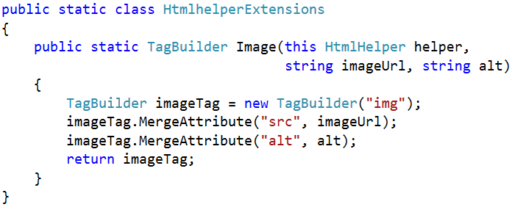

Custom Helpers
Write extension methods for the HtmlHelper
Return string or override ToString method
TagBuilder manages closing tags and attributes
Add namespace in web.config (if needed)

Slide 45
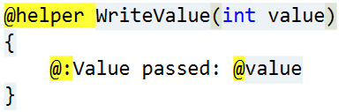
Custom Helpers (2)
Another way to write helpers:
Create folder /App_Code/
Create a view in it (for example Helpers.cshtml)
Write a helper in it using @helper
You can use the helper in any view
You have a lot of code in views? => write helpers

Slide 46
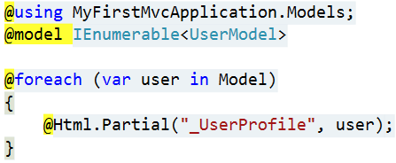
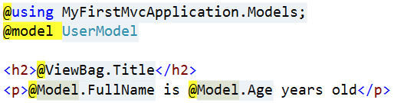
Partial Views
Partial views render portions of a page
Reuse pieces of a view
Html helpers – Partial, RenderPartial and Action
Razor partial views are still .cshtml files
Sub-request
Located in the same folder as other views or in Shared folder

Slide 47
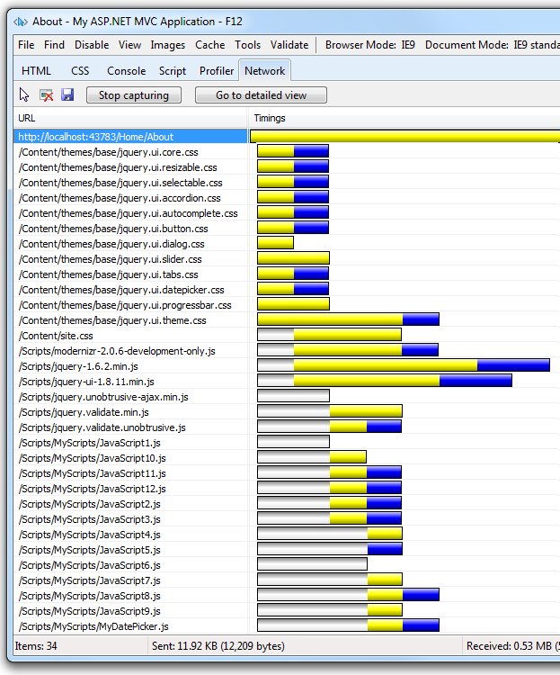
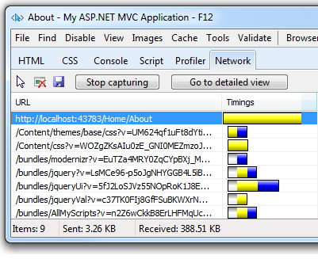
Bundling and Minification

Slide 48
Bundling
Makes it easy to combine or bundle multiple files into a single file
You can create CSS, JavaScript and other bundles
Fewer files means fewer HTTP requests and that can improve first page load performance

Slide 49
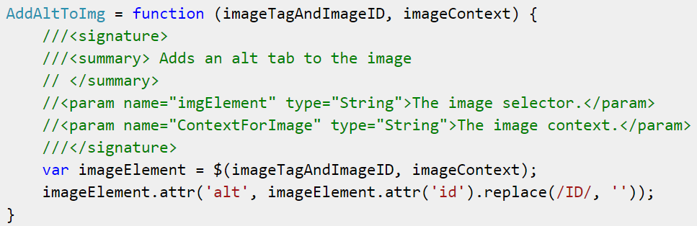
Minification
Performs a variety of different code optimizations to scripts or CSS such as:
removing unnecessary white space and comments
shortening variable names to one character

Slide 50
Controlling Bundling and Minification
Enabled or disabled by setting the value of the debug attribute in the compilation Element in the Web.config
To enable bundling and minification, set the debug value to "false"
Can be overrided the setting with EnableOptimizations property on the BundleTable class
public static void RegisterBundles(BundleCollection bundles)
{
bundles.Add(new ScriptBundle("~/bundles/jquery").Include(
"~/Scripts/jquery-{version}.js"));
BundleTable.EnableOptimizations = true;
}

Slide 51
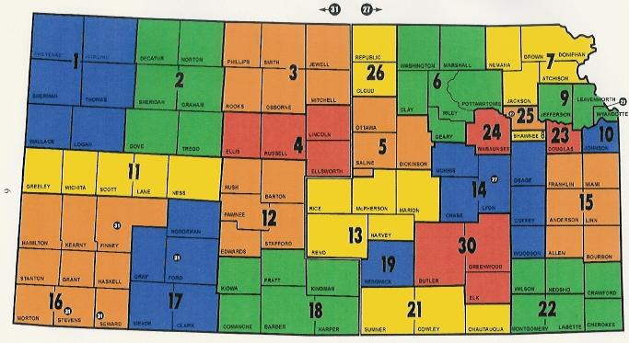
Areas

Slide 52
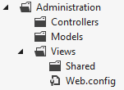
Areas
Some applications can have a large number of controllers
ASP.NET MVC lets us partition Web applications into smaller units (areas)
An area is effectively an MVC structure inside an application
Example: large e-commerce application
Main store, users
Blog, forum
Administration

Slide 53
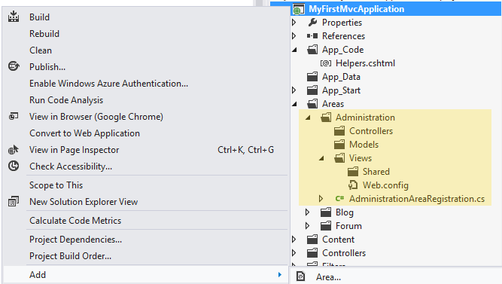
Live Demo: Areas
ASP.NET MVC structures (areas)

Slide 54
Summary
Routes maps URLs to controllers and actions
Controllers are the brain of our application
Actions are the ultimate request destination
Razor is a powerful engine for combining models and templates into HTML code
Layout, sections, partials views and helpers help us to divide our views into pieces
Our project can be divided into smaller parts containing controllers (areas)

Slide 55
ASP.NET MVC Essentials
http://academy.telerik.com

Slide 56



Free Trainings @ Telerik Academy
“C# Programming @ Telerik Academy
csharpfundamentals.telerik.com
Telerik Software Academy
academy.telerik.com
Telerik Academy @ Facebook
facebook.com/TelerikAcademy
Telerik Software Academy Forums
forums.academy.telerik.com

